Slide 1
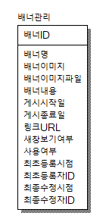
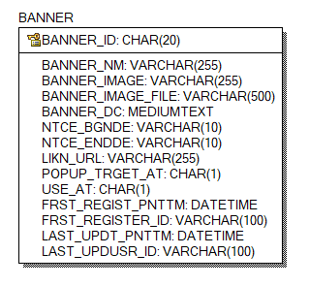
CREATE TABLE BANNER
(
BANNER_ID CHAR(20) NOT NULL,
BANNER_NM VARCHAR(255) NULL,
BANNER_IMAGE VARCHAR(255) NULL,
BANNER_IMAGE_FILE VARCHAR(500) NULL,
BANNER_DC MEDIUMTEXT NULL,
NTCE_BGNDE VARCHAR(10) NULL,
NTCE_ENDDE VARCHAR(10) NULL,
USE_AT CHAR(1) NULL,
FRST_REGIST_PNTTM DATETIME NULL,
FRST_REGISTER_ID VARCHAR(100) NULL,
LAST_UPDT_PNTTM DATETIME NULL,
LAST_UPDUSR_ID VARCHAR(100) NULL,
LIKN_URL VARCHAR(255) NULL,
POPUP_TRGET_AT CHAR(1) NULL
);
ALTER TABLE BANNER
ADD PRIMARY KEY (BANNER_ID);
ALTER TABLE BANNER COMMENT = '배너관리';

Slide 2
ALTER TABLE BANNER CHANGE COLUMN BANNER_ID BANNER_ID CHAR(20) NOT NULL COMMENT '배너ID’;
(이하 앞에 내용 전체동일 ALTER TABLE BANNER CHANGE COLUMN ~~~)
BANNER_NM BANNER_NM VARCHAR(255) NULL COMMENT '배너명’;
BANNER_IMAGE BANNER_IMAGE VARCHAR(255) NULL COMMENT '배너이미지’;
BANNER_IMAGE_FILE BANNER_IMAGE_FILE VARCHAR(500) NULL COMMENT '배너이미지파일’;
BANNER_DC BANNER_DC MEDIUMTEXT NULL COMMENT '배너내용’;
NTCE_BGNDE NTCE_BGNDE VARCHAR(10) NULL COMMENT '게시시작일’;
NTCE_ENDDE NTCE_ENDDE VARCHAR(10) NULL COMMENT '게시종료일’;
LIKN_URL LIKN_URL VARCHAR(255) NULL COMMENT '링크URL’;
POPUP_TRGET_AT POPUP_TRGET_AT CHAR(1) NULL COMMENT '새창보기여부’;
USE_AT USE_AT CHAR(1) NULL COMMENT '사용여부’;
FRST_REGIST_PNTTM FRST_REGIST_PNTTM DATETIME NULL COMMENT '최초등록시점’;
FRST_REGISTER_ID FRST_REGISTER_ID VARCHAR(100) NULL COMMENT '최초등록자ID’;
LAST_UPDT_PNTTM LAST_UPDT_PNTTM DATETIME NULL COMMENT '최종수정시점’;
LAST_UPDUSR_ID LAST_UPDUSR_ID VARCHAR(100) NULL COMMENT '최종수정자ID';

Slide 3
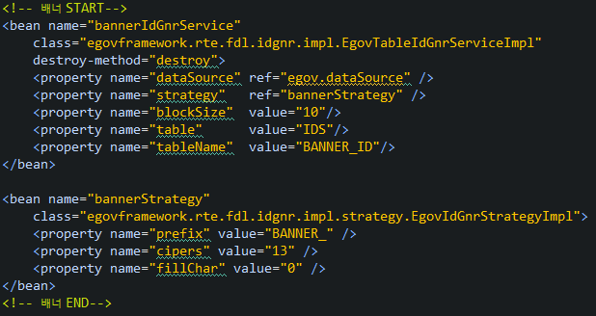
ID젠 추가
INSERT INTO ids(
TABLE_NAME
,NEXT_ID
) VALUES (
'BANNER_ID'
,1
)

Slide 4

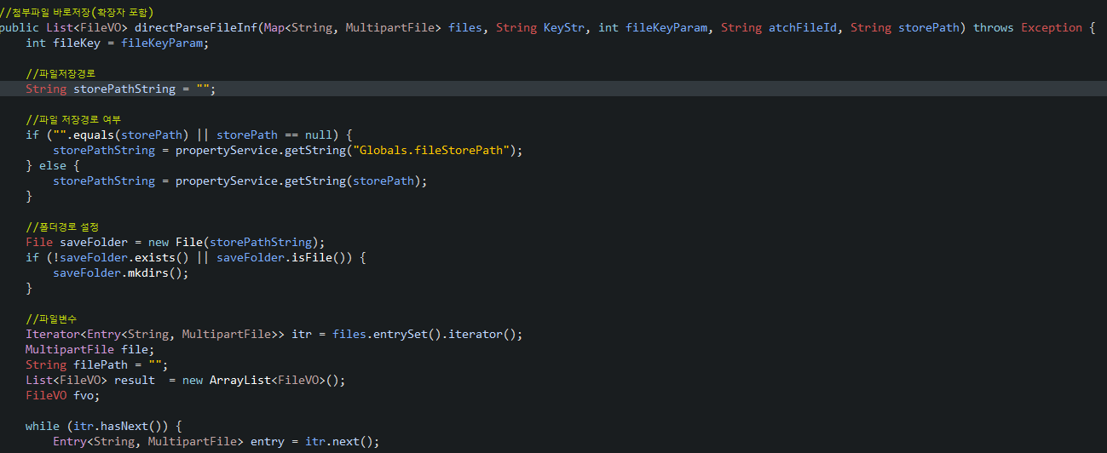
properties 배너 경로 추가
FileMngUtil에 directParseFileInf 메소드 추가

Slide 5
스크립트 파일
<script src="/asset/rolling.js"></script>

Slide 6
메인페이지에 배너호출 import 생성
<c:import url="/banner/bannerService.do" charEncoding="utf-8"/>

